Slide 1

Will They Churn?

Slide 2


AGENDA
Business Problem
FP and FN
Data and EDAs
Models
Business Suggestion

Slide 3

MEET SYRIATEL
Founded in January 2000
Mobile Network Provider
Based out of Syria
Currently facing the challenge of losing customers.
Want a model that will predict if a customer will churn or not.
This model will help reduce how much money is lost because of customers who churn.

Slide 4

Positive or Negative?
True Positive: The Customer stops doing business.
True Negative: The Customer continues doing business.
False Positive: Predict the Customer will stop doing business, but they continue.
False Negative: Predict the Customer will continue doing business, but they stop.
FN
In our case, a False Negative would be worst.
Telling SyriaTel, a customer will not churn but in fact does churn will cause them to lose money.
Because of this, our model focuses on Recall.

Slide 5
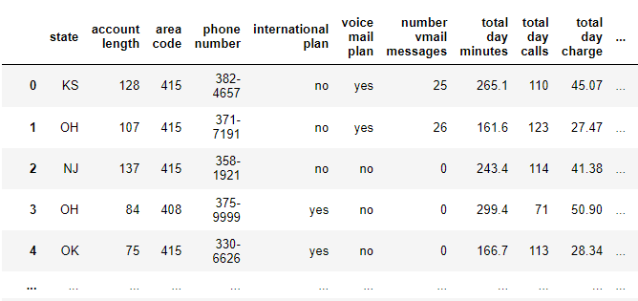
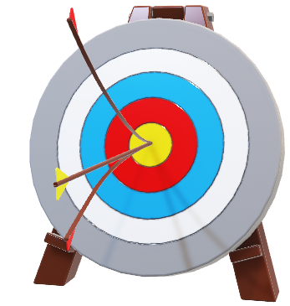
Our Data
CHURN
Retrieved from Kaggle.
Consists of 3,333 SyriaTel Customers located in the US.
Spans across all 51 states, including Washington, D.C.
Includes information such as total used minutes, add-on plans, and customer service calls.

Slide 6
Our Objectives
Conduct an exploratory data analysis on the existing dataset.
Establish a baseline model using logistic regression.
Apply machine learning algorithm Decision Tree to build a classifier
Use the model for classification

Slide 7
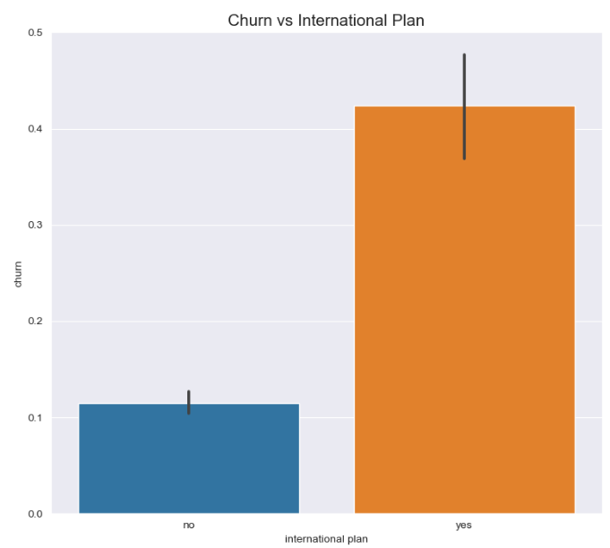
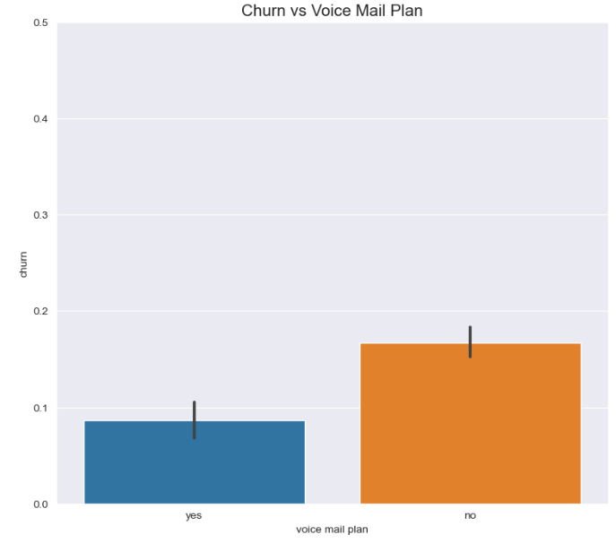
Comparison between Churn vs International Plan and Voice Mail Plan

Slide 8
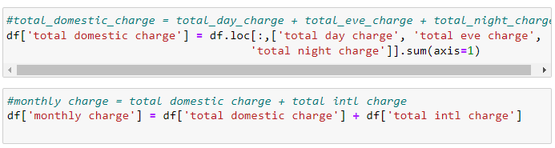
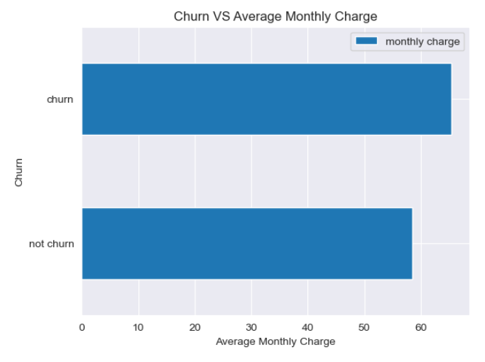
Created a formula to calculate total monthly charges.
Started with domestic charges (day, evening and night) and added them to international charges.

Slide 9
The Models

Slide 10
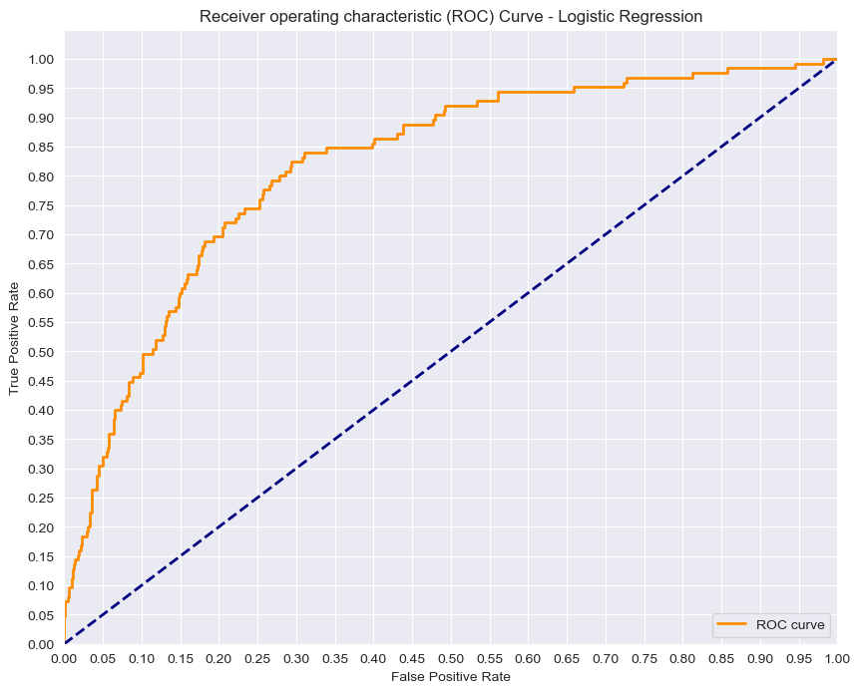
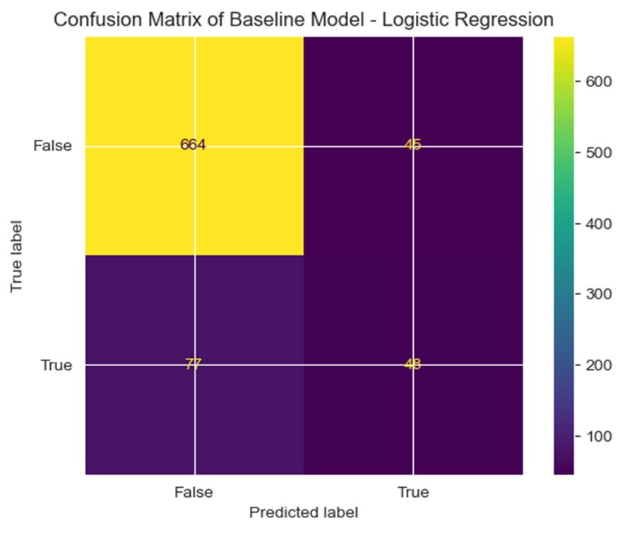
AUC: 0.818 ( 82% )
RECALL: 0.384 ( 38% )

Slide 11
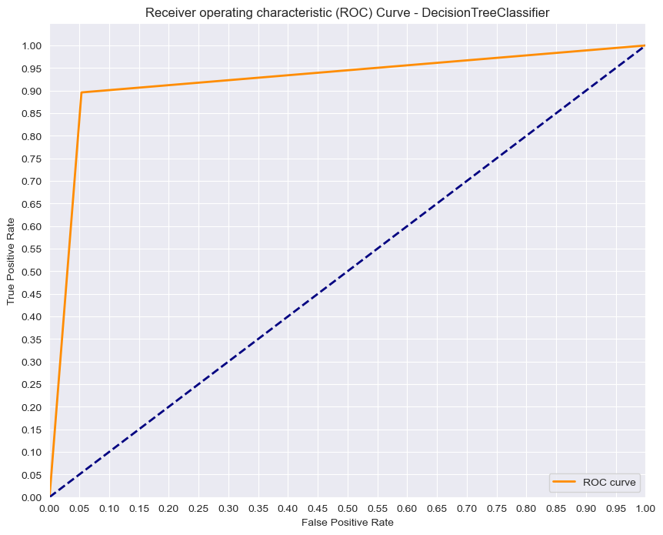
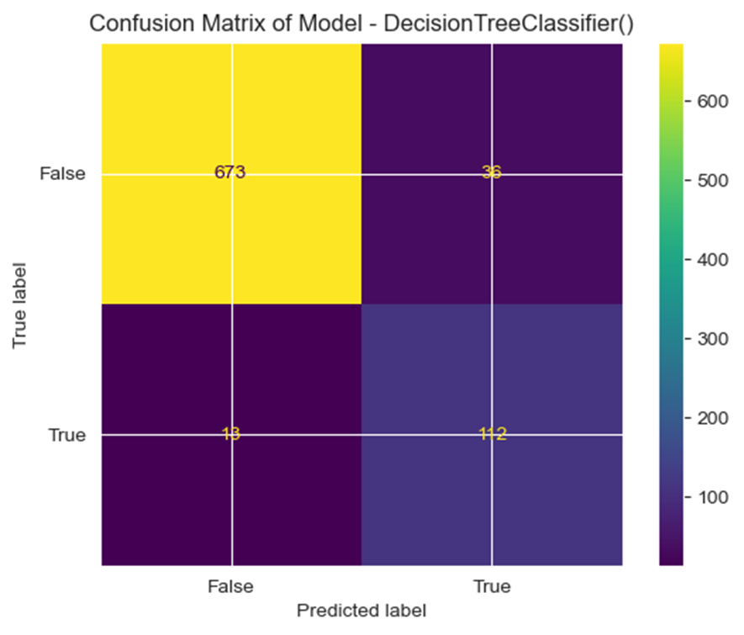
AUC: 0.921 ( 92% )
RECALL: 0.896 ( 90% )

Slide 12
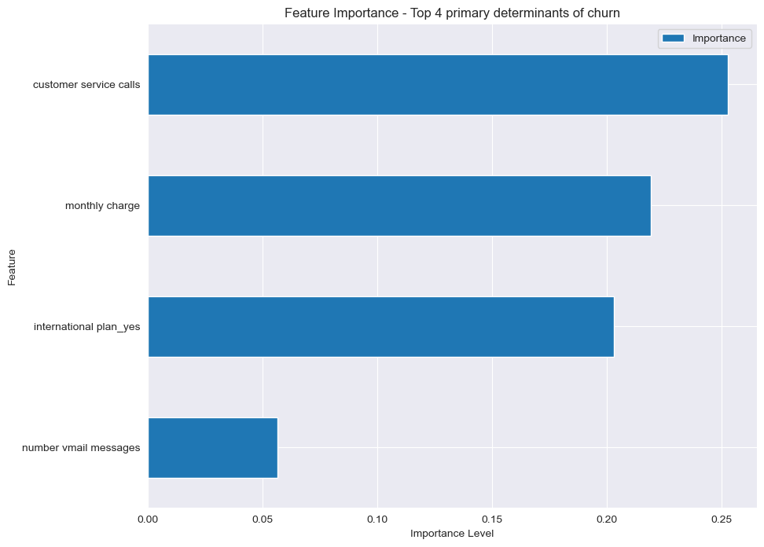
In Conclusion
With our predictive model having a Recall Score of 90%, We found the customers who are mostly likely to churn are those with:
High monthly charges
The International Plan
High number of Voice Mail messages
Frequent Customer Service calls
We suggest using the model to predict which customers will churn.
And take appropriate actions to try to retain their services.

Slide 13
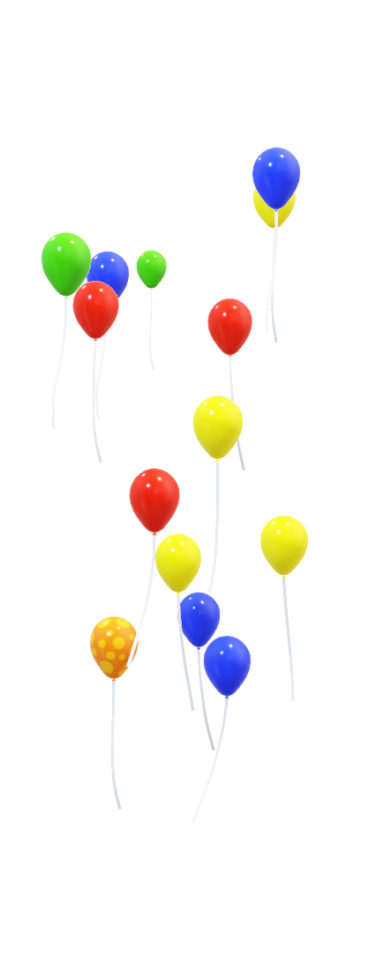
THANK YOU!
Lotus Baumgarner
https://www.linkedin.com/in/lotus-baumgarner/
AND
Musa Irshad
https://www.linkedin.com/in/musairshad/
https://github.com/musairshad/syriatel-churn-analysis

